Slide 1
Portable Linux Console
By: Ehsan Hussain & Luca Ragosta

Slide 2
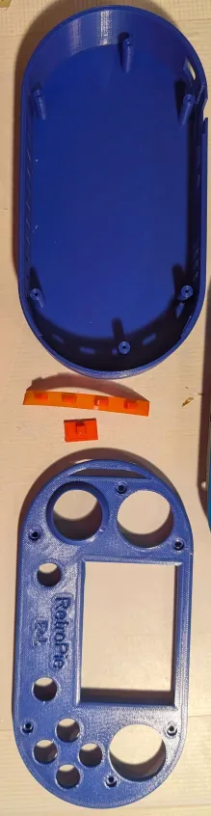
Project description
Basic Handheld Console
Includes a Raspberry Pi & a Game Hat
Build around a 3d printed shell

Slide 3
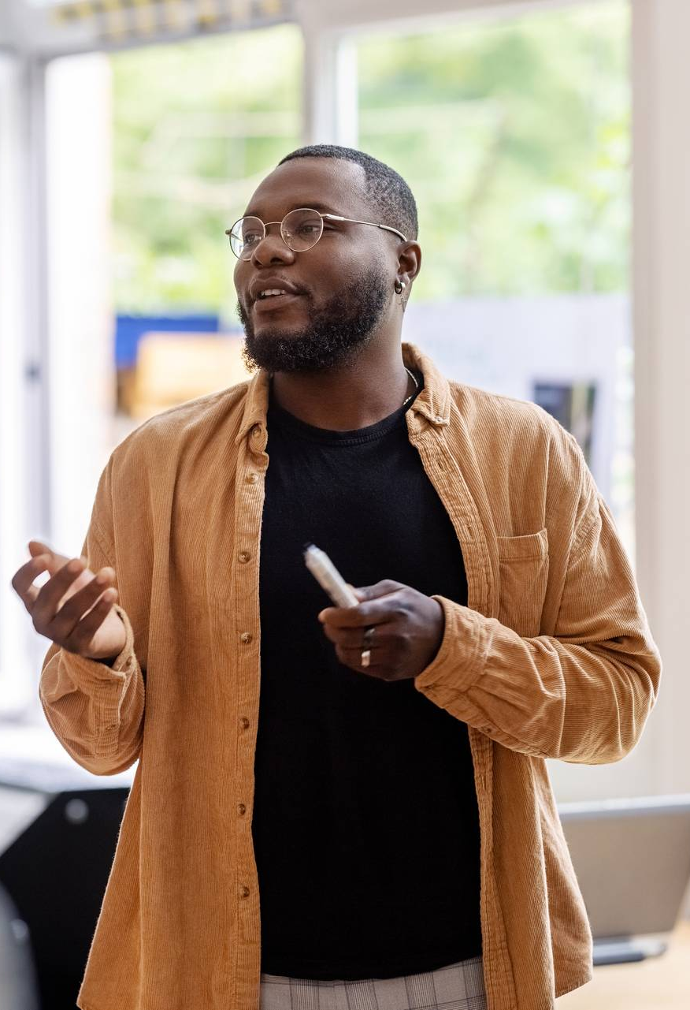
Motivation
Interesting idea
Combines both material and digital
Good to learn Raspberry Pi & 3D Printing

Slide 4


Major TECHNICAL solutions
Progress of our project
Raspberry pi + Wine & Box86/64 for computer games
Raspberry Pi OS to run RetroPie
Using only RetroPie
Changed game (Fallout -> Doom)
Notes:
L = what and Why, E = Why not
2-4. E = why

Slide 5
Demo

Slide 6

Git Repository tour
Readme.md
Choices.md
License.md
Install.md
Game-HAT-200730.tar.gz (Driver.zip)
retropie-buster-4.8-rpi4_400.img.gz (RetroPie-image.zip)
Waveshare Game Hat case - 3752237.zip (outer-case-3D-printing-script.zip)
https://github.com/Ehsan-Hussain-for-work/Unix_Project_PersonalConsole.git

Slide 7

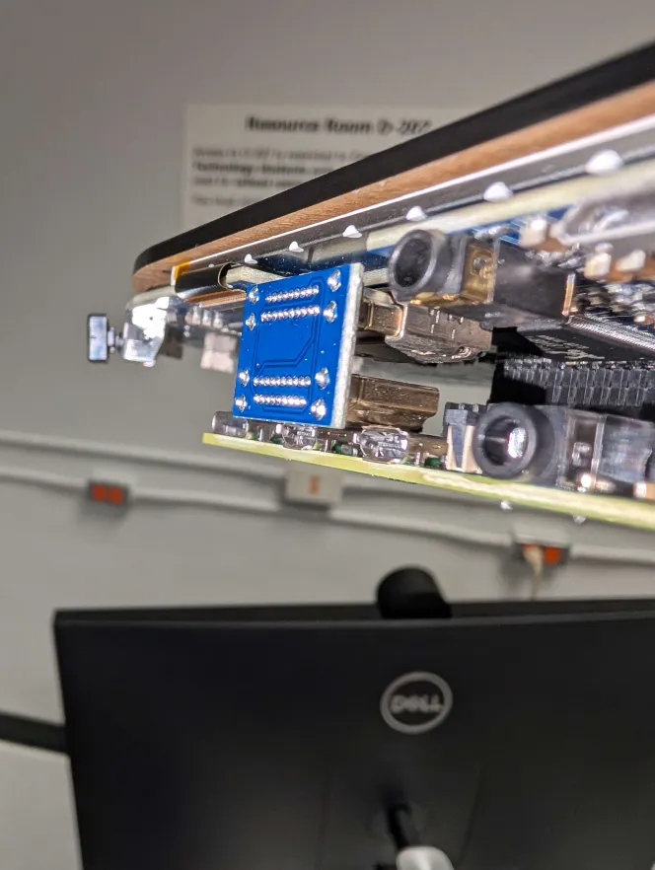
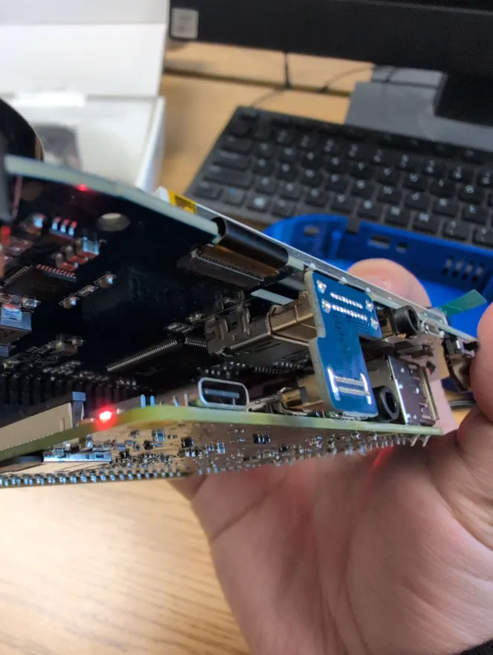


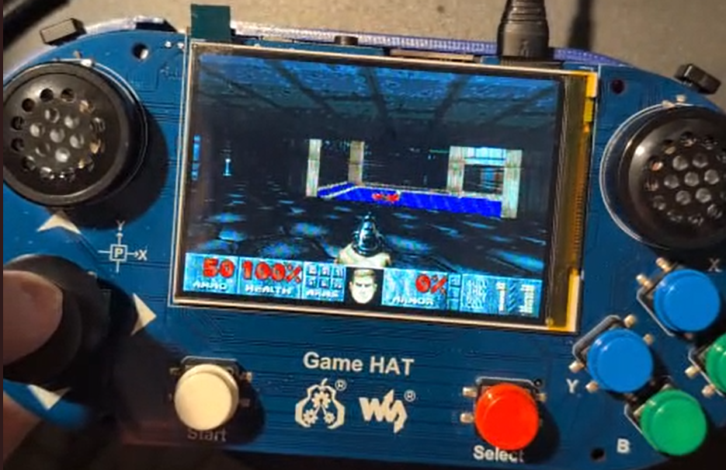
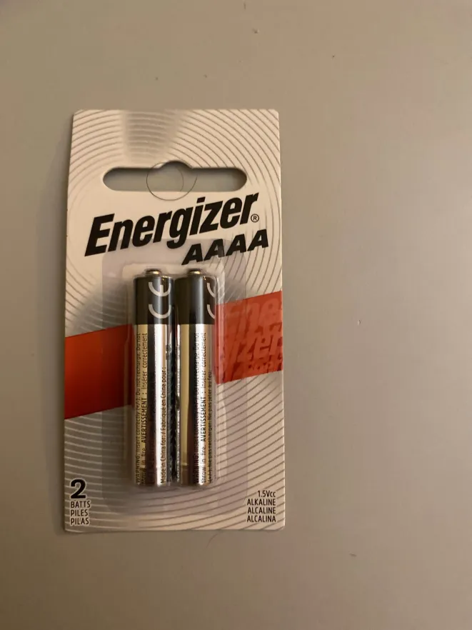
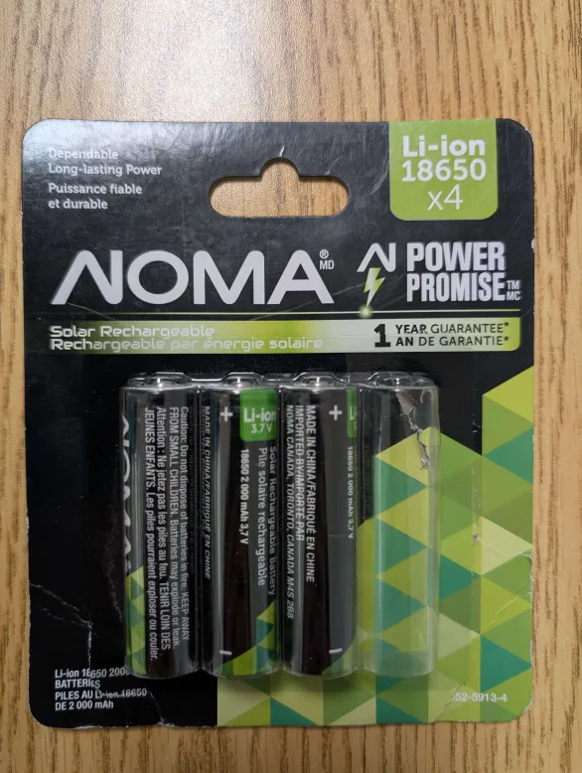
Development Journey
GameHat RaspberryPi Connection Problem
Nov27th
Dec1st
Dec5th
TIMELINE
Battery Problem
Nov25th
Nov27th
Dec6th

Slide 8
MAJOR CHALLENGES
ACCOMPLISHMENTS
Challenges
- 3D printing quality
- slow start
- Constant OS changes
- Strick driver compatibility
- Missing/misconfigured hardware
- SSH misconceptions
- Choosing a valid game
Accomplishments
- 3D printed without trial & error
- Finished the basics within a week
- Found a perfect guide with clear steps
- Found valuable online forums
- Found a game perfect for testing

Slide 9
Material Costs
Materials | Options | Cost (CAD) | Total
Raspberry Pi (A+ to 4B) | Raspberry Pi Zero + HDMI cable | $87.00 | $87.00
Game HAT | controller, monitor and speakers | $64.95 | $151.95
18650 lithium battery | 5V/2A powered USB-C charging plug | $19.99 | $171.94
Micro-SD card | Any storage size | $15.95 | $187.89
3D printed shell | Leaving the device exposed | $0.15 | $188.04

Slide 10

Future plans
Adding compatibility for more games
Making shell design sleeker

Slide 11
Why to get it
- Open source
- Unlimited Compatibility(Sky’s the limit!)
-No extra unwanted software

Slide 12
Any Questions?

Slide 13
Thank you
Ehsan Hussain (6274100)
Luca Ragosta (2292232)

